Slide 1
What Dog is that Meme?
Group Members: Justine Pintauro, Dion davis, sam dailey, joel boyette

Slide 2
Overview
Analysis of 1000 images of various Dog memes to predict the breed of Dog in the meme.
How accurate does the Dog meme identify with the correct breed of dog?
What is the most popular Dog identified in the Dog memes?

Slide 3
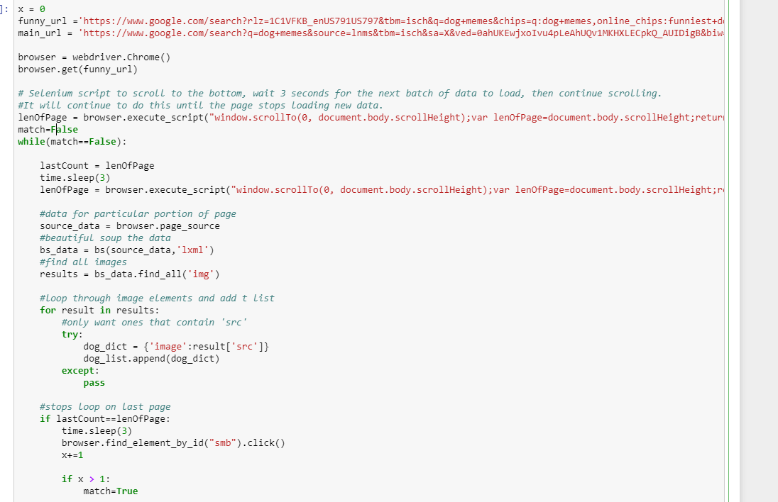
Web Scraping – Google Images
Used the selenium python library
Used google image search results URL's
Had to figure out how to scrape a webpage that was an infinite scroll. Code is below

Slide 4
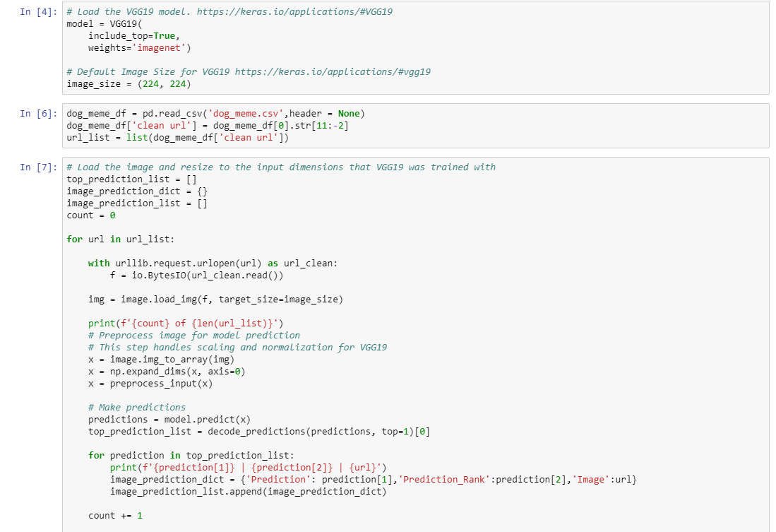
Predicting the Dog Breed
Used the Keras built-in VGG19 model
Had to clean the URL using python library urllib for keras to read the images
Dump the predictions into a mongo db collection

Slide 5
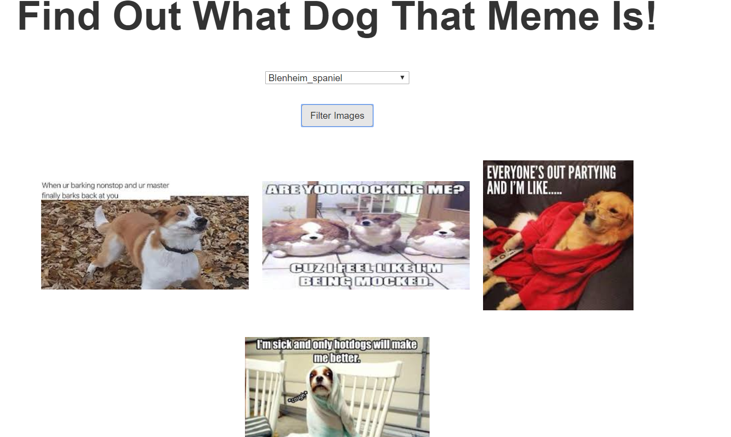
Finding what dog is that Meme
Used python script with flask to connect to mongo and serve up to webpage.
Used Javascript d3 library to create the <img> tags and filter the dog meme’s based on the dropdown input.

Slide 6
Analysis
The most popular dog identified in the Dog memes was the Chihuahua breed.
The top 5 most predicted Dogs identified in the Dog memes are:
Chihuahua (38%)
Golden Retriever (37%)
Pug (29%)
Labrador Retriever (21%)
Great Dane (16%)

Slide 7
Issues
The accuracy of the model identified objects more than the breed of dog found in some of the Dog memes.

Slide 8
References

